Slide 1


Pigeonhole sorting
Parallel Programming
-PasupuletI ROHITH SAI DATTA
-CHINMAYA DAYANANDA KAMATH

Slide 2
Introduction
Pigeonhole sorting works well when the number of elements is close to the number of key values.
Pigeonhole sorting takes O(n + Range) time, where 'n' is the number of elements, and 'Range' is the possible value range in the array.
Pigeonhole sorting is a non-comparison-based sort, which makes it faster for certain applications.
Pigeonhole sorting is a stable sorting algorithm.
Pigeonhole sorting operates with a linear time complexity for sorting.

Slide 3
Working of Algorithm
1. Find minimum and maximum values in the array. Let the minimum and maximum values be ‘min’ and ‘max’ respectively. Also, find the range as ‘max-min+1’.
2. Set up an array of initially empty “pigeonholes” the same size as the range.
3. Visit each array element and then put each element in its pigeonhole. An element arr[i] is put in the hole at index arr[i] – min.]
4. Start the loop all over the pigeonhole array in order and put the elements from non-empty holes back into the original array.

Slide 4
Sequential pseudo code
void pigeonhole_sort(int arr[], int n, int min_val, int range_size, int* sorted_arr) {
int pigeonholes[range_size];
for (int i = 0; i < range_size; i++) {
pigeonholes[i] = 0;
}
for (int i = 0; i < n; i++) {
pigeonholes[arr[i] - min_val]++;
}
int index = 0;
for (int i = 0; i < range_size; i++) {
while (pigeonholes[i] > 0) {
sorted_arr[index++] = i + min_val;
pigeonholes[i]--;
}
}
}

Slide 5

parallel algorithm idea
Initialize:
Import necessary libraries.
Define the pigeonhole sort function.
Main Function:
Initialize MPI:
Get process rank and size.
If rank is 0, input total number of elements.
Broadcast total elements to all processes.
Divide data among processes using Scatter.
Local Sorting:
Find local minimum and maximum values.
Reduce to get global minimum and maximum values.
Calculate range size for pigeonhole sorting.

Slide 6
Parallel algorithm idea
Pigeonhole Sort:
Perform pigeonhole sorting on local arrays.
Gather and Print:
Gather sorted sub-arrays from all processes.
If rank is 0, print the sorted array.
Finalize:
Finalize MPI.
Return:
Return from main function.

Slide 7

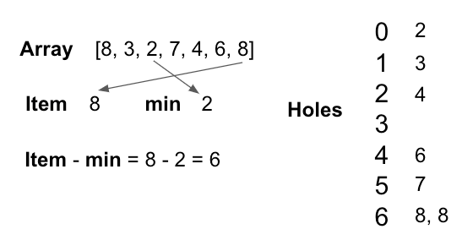



Slide 8
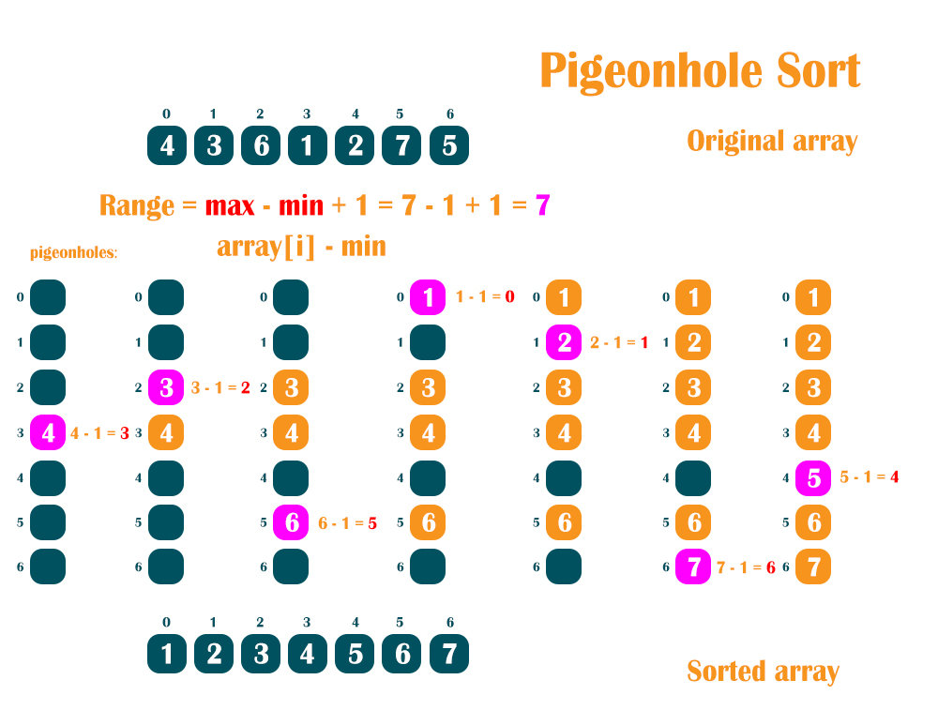

Slide 9
Thank You

